Slide 1
PawnHub
End-user presentation

Slide 2
What is PawnHub?
Web app connecting customers with pawnshops
Simplifies browsing, listing, and managing pawned items
Modern, user-friendly alternative to traditional pawnshops
Streamlines communication and transactions

Slide 3
Registration
Creating a Customer or a Shop account

Slide 4
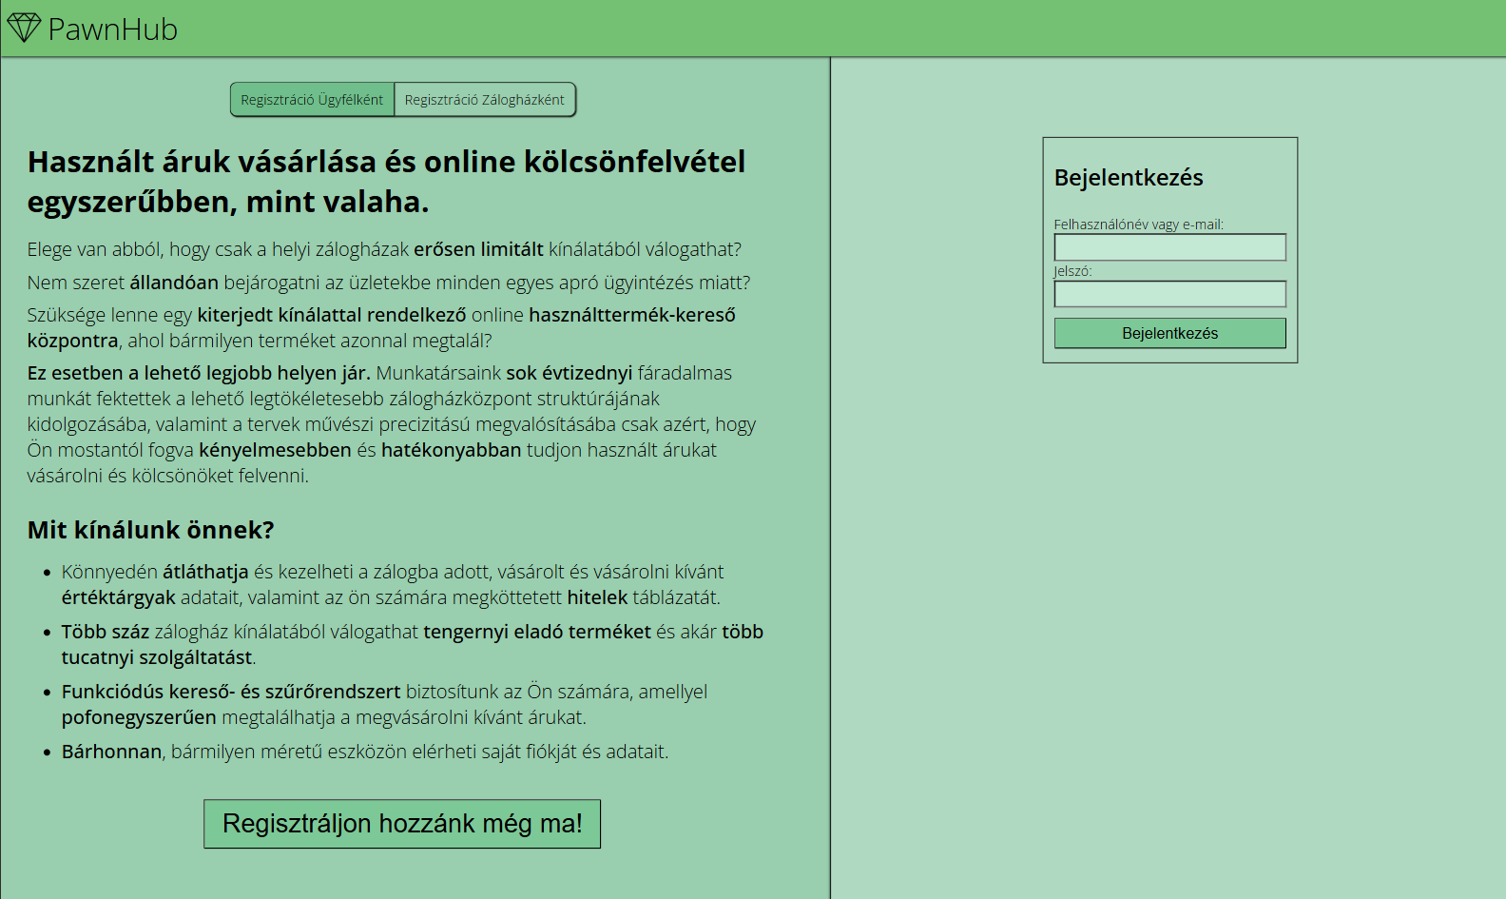

Slide 5
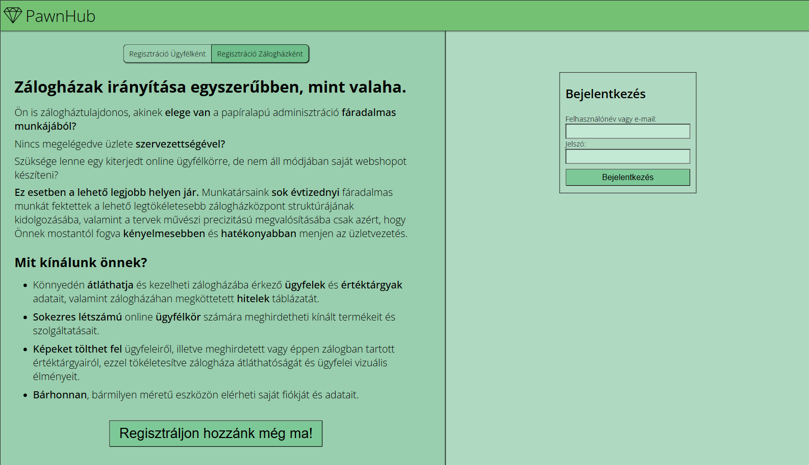

Slide 6
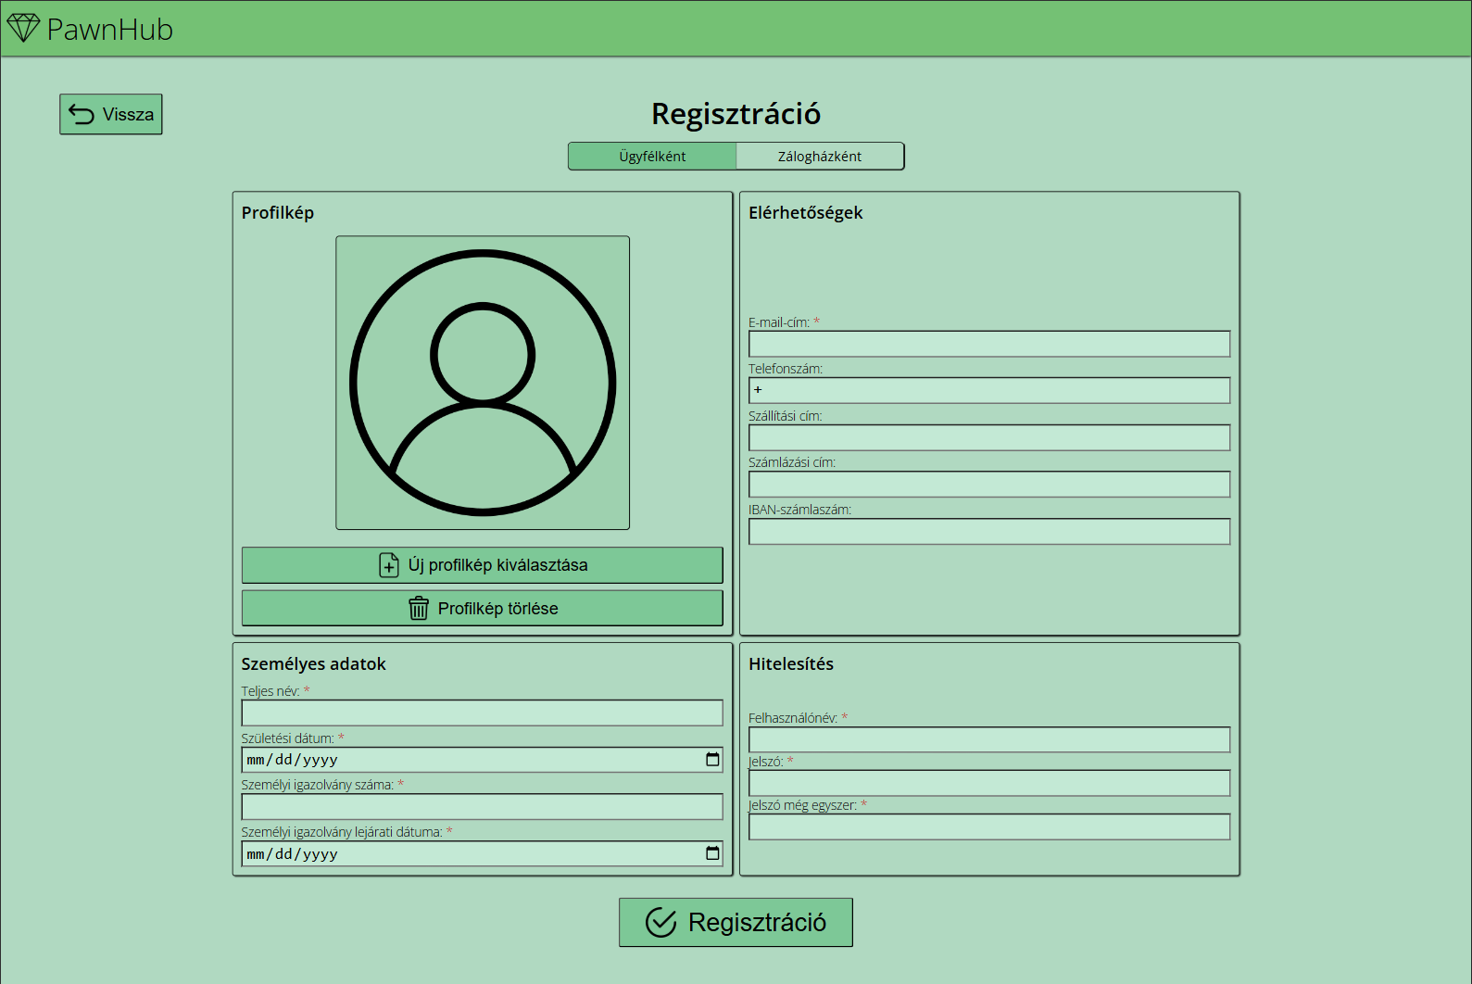

Slide 7
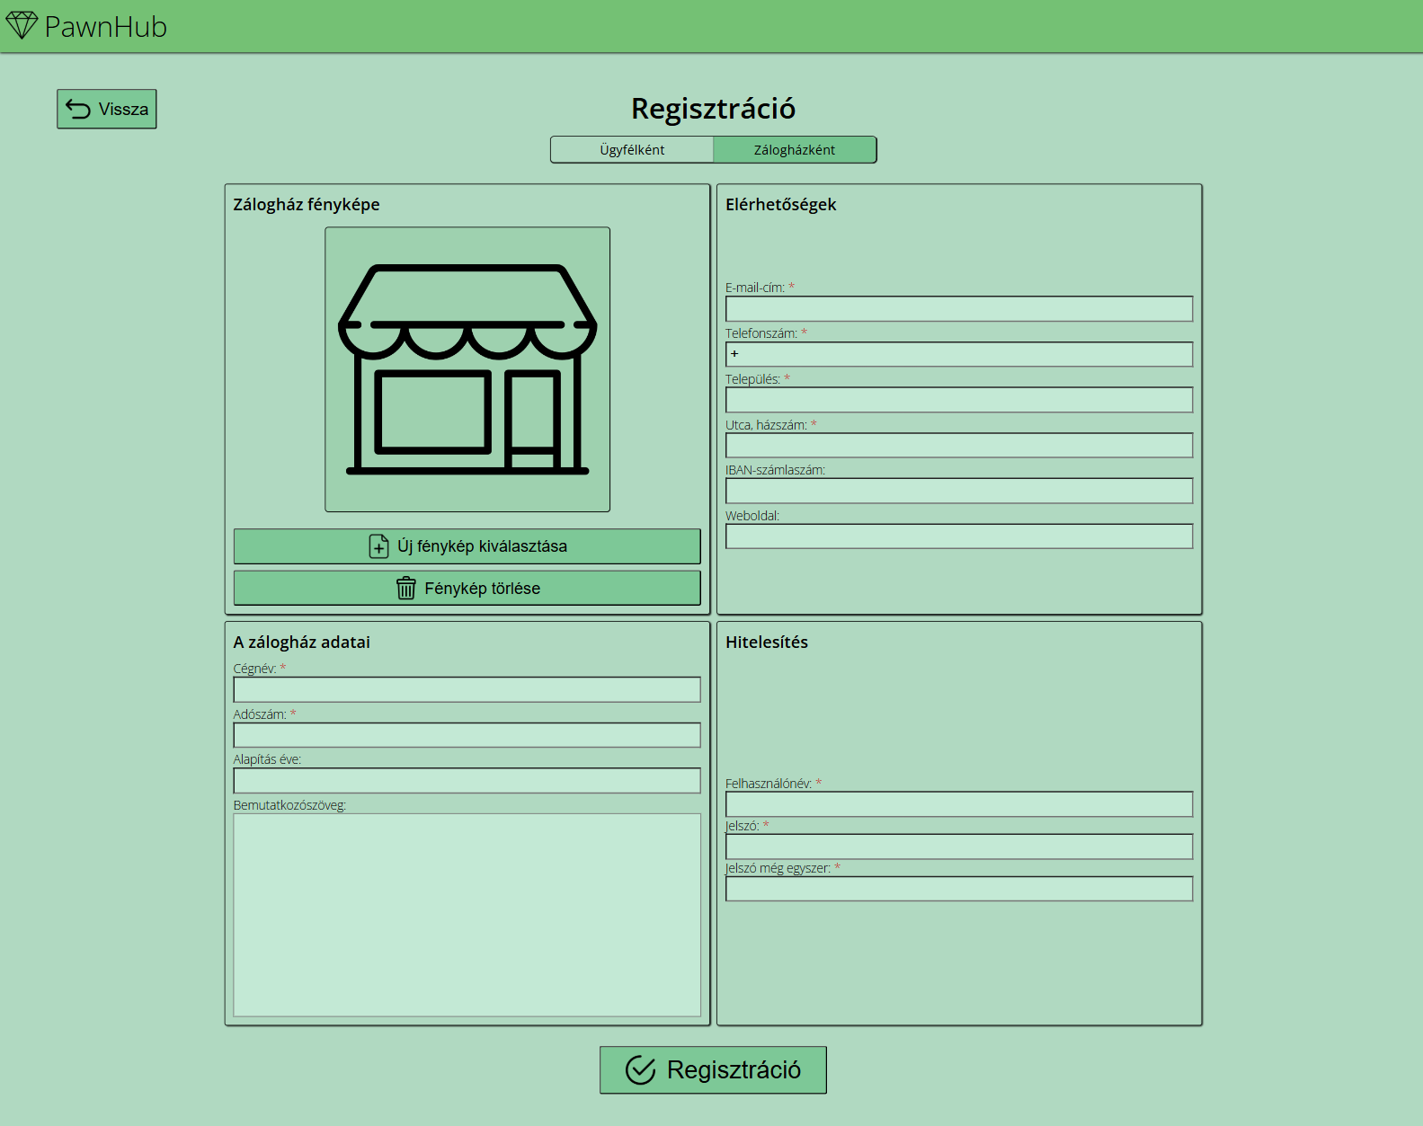

Slide 8
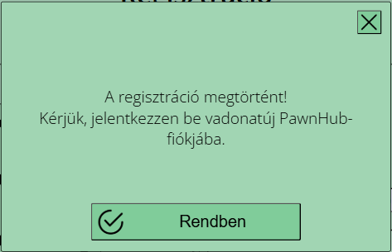

Slide 9
Log in
Logging in to your PawnHub account

